Slide 1
PDS
SDN
NFV
Computer Vision
Chapter 9:
Video Preprocessor and Augmentation for
Deep learning
tasks
https://github.com/siagianp
https://www.youtube.com/@AmelOline/videos
Notes:
Efficient Video Dataset Loading and Augmentation in PyTorch
https://github.com/RaivoKoot/Video-Dataset-Loading-Pytorch
https://github.com/jfzhang95/pytorch-video-recognition/blob/master/dataloaders/dataset.py

Slide 2
Outlines
B asics of Image Processing; What is preprocessing?
T ools and Libraries
I mage Data Preprocessing Steps
Notes:
https://medium.com/@Coursesteach/image-preprocessing-using-python-2db2fd91618a

Slide 3
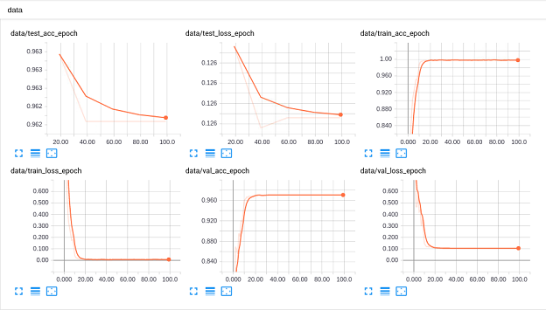
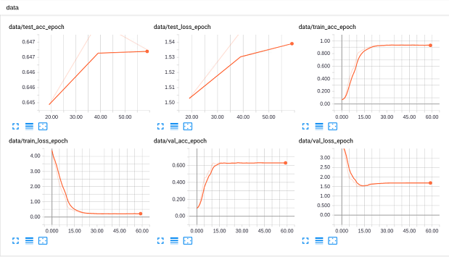
https://github.com/jfzhang95/pytorch-video-recognition

Slide 4
As mentioned already, the preprocessing steps you will need for your dataset depend on the nature of the dataset and models you want to train. Possible preprocessing steps for images are:
Image Data Preprocessing Steps
Raw dataset
Clean dataset
Preprocessing
Image loading
Image Description
Image Vocalization
Image Transformations
Feature Detection and Description
Prepare Data for Training

Slide 5
Getting images ready for use means taking them from wherever they’re stored and bringing them into memory. You can do this with tools like PIL or OpenCV. This makes the images easier to work with and study. OpenCV can load images in formats like PNG, JPG, TIFF, and BMP. You can load an image with (Dataset)
Step 1: Data Loading
from google.colab import drive drive.mount('/content/gdrive')
import glob import os import random import matplotlib import warnings import numpy as np import matplotlib.pyplot as plt from skimage import io from skimage import img_as_float from skimage.transform import resize, rotate from skimage.color import rgb2gray %matplotlib inline warnings.simplefilter('ignore')

Slide 6
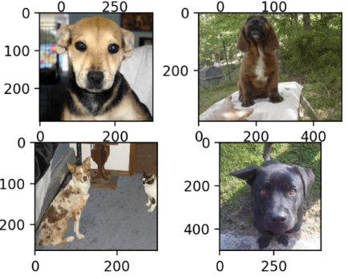
# Create a list of all images (replace with your actual Google Drive path) root_path = '/content/gdrive/MyDrive/Datasets' print("Root path:", root_path) all_images = glob.glob(root_path + '/*.jpg') print("All images:", all_images)
# To avoid memory errors we will only use a subset of the images all_images = random.sample(all_images, 500)
Image example 1
Image example 2
# Plot a few images i = 0 fig = plt.figure(figsize=(10, 10)) for img_path in all_images[:4]: img_arr = io.imread(img_path) i += 1 ax = fig.add_subplot(2, 2, i) ax.imshow(img_arr) ax.set_title(f"Image example {i}")
Image example 3
Image example 4

Slide 7
Thank you!
Thank you For being a great class!
PDS
Computer Vision
https://github.com/siagianp
https://www.youtube.com/@AmelOline/videos

